Slide 1


Experiment 8
Delta-Wye Transformer – 4 wire – Solidly Grounded System
Unbalanced Load and Ground Fault
Dr. Norbert Doerry and Dr. John V. Amy Jr.
http://doerry.org/norbert/MarineElectricalPowerSystems/index.htm
© 2024 by Norbert Doerry and John Amy
This work is licensed via: CC BY 4.0 (https://creativecommons.org/)

Slide 2

Schematic
$$V_{secondary_ll}=\frac{\sqrt{3}}{n}V_{primary}=\frac{\sqrt{3}}{5.2}208=69.3 volts rms (98 V peak)$$
$I_{secondary}=\frac{n}{\sqrt{3}}I_{primary }$
(Neglecting losses)
C_{p} = 2.2 µF
R = 1200 Ω
R_{L} = 300 Ω
R_{La} = 200 - 300 Ω
R_{lamp} = 450 Ω
N = 5.2
R_{lamp}
Common Mode Current Probe
Current Meter (all phases)
Voltage Meter (all phases)

Slide 3
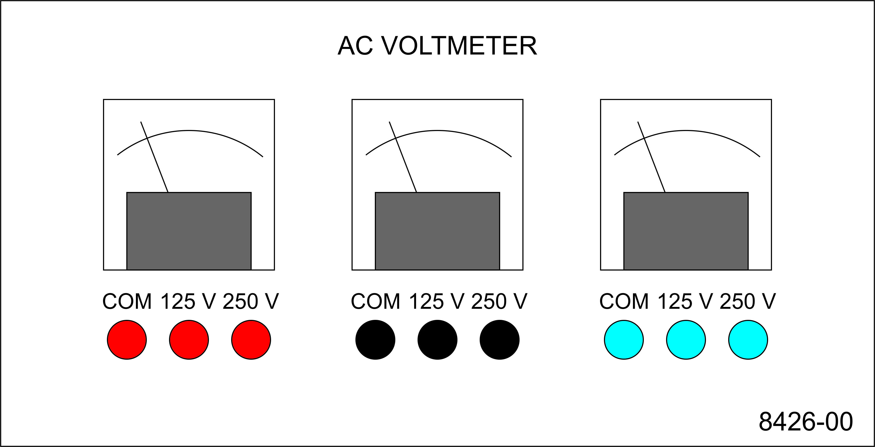
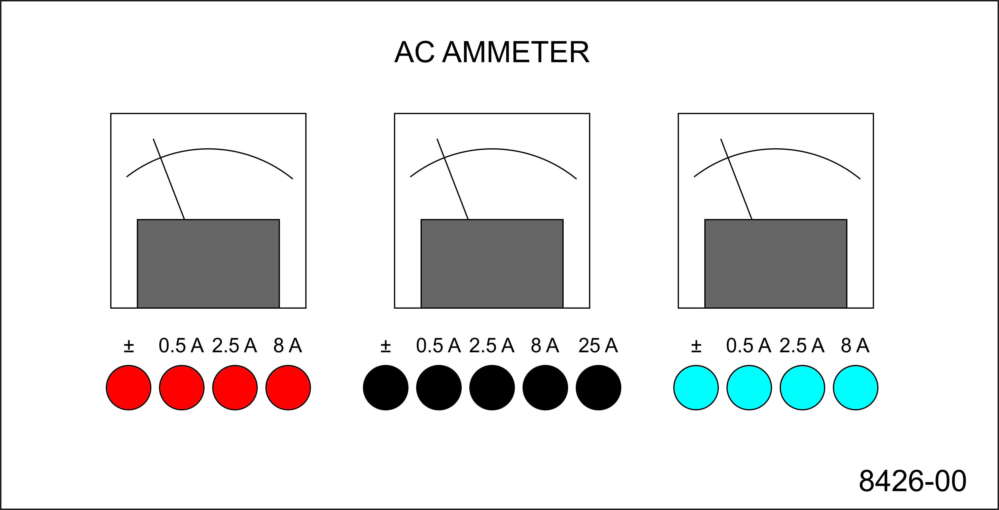
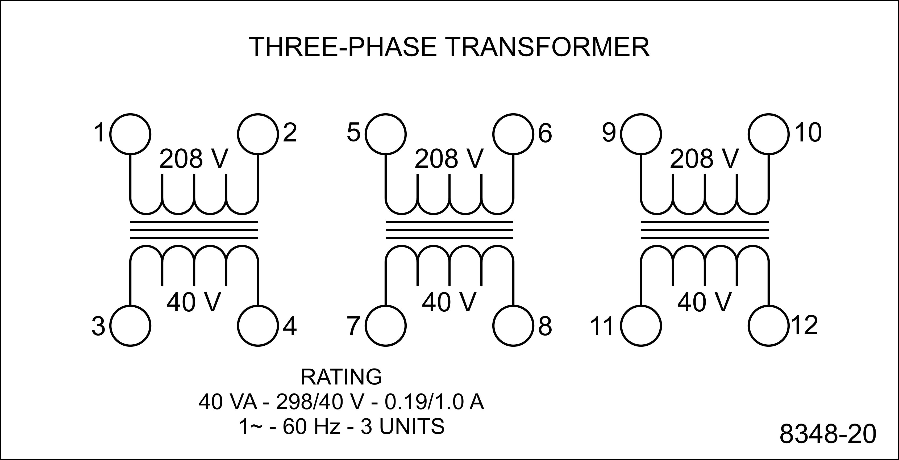
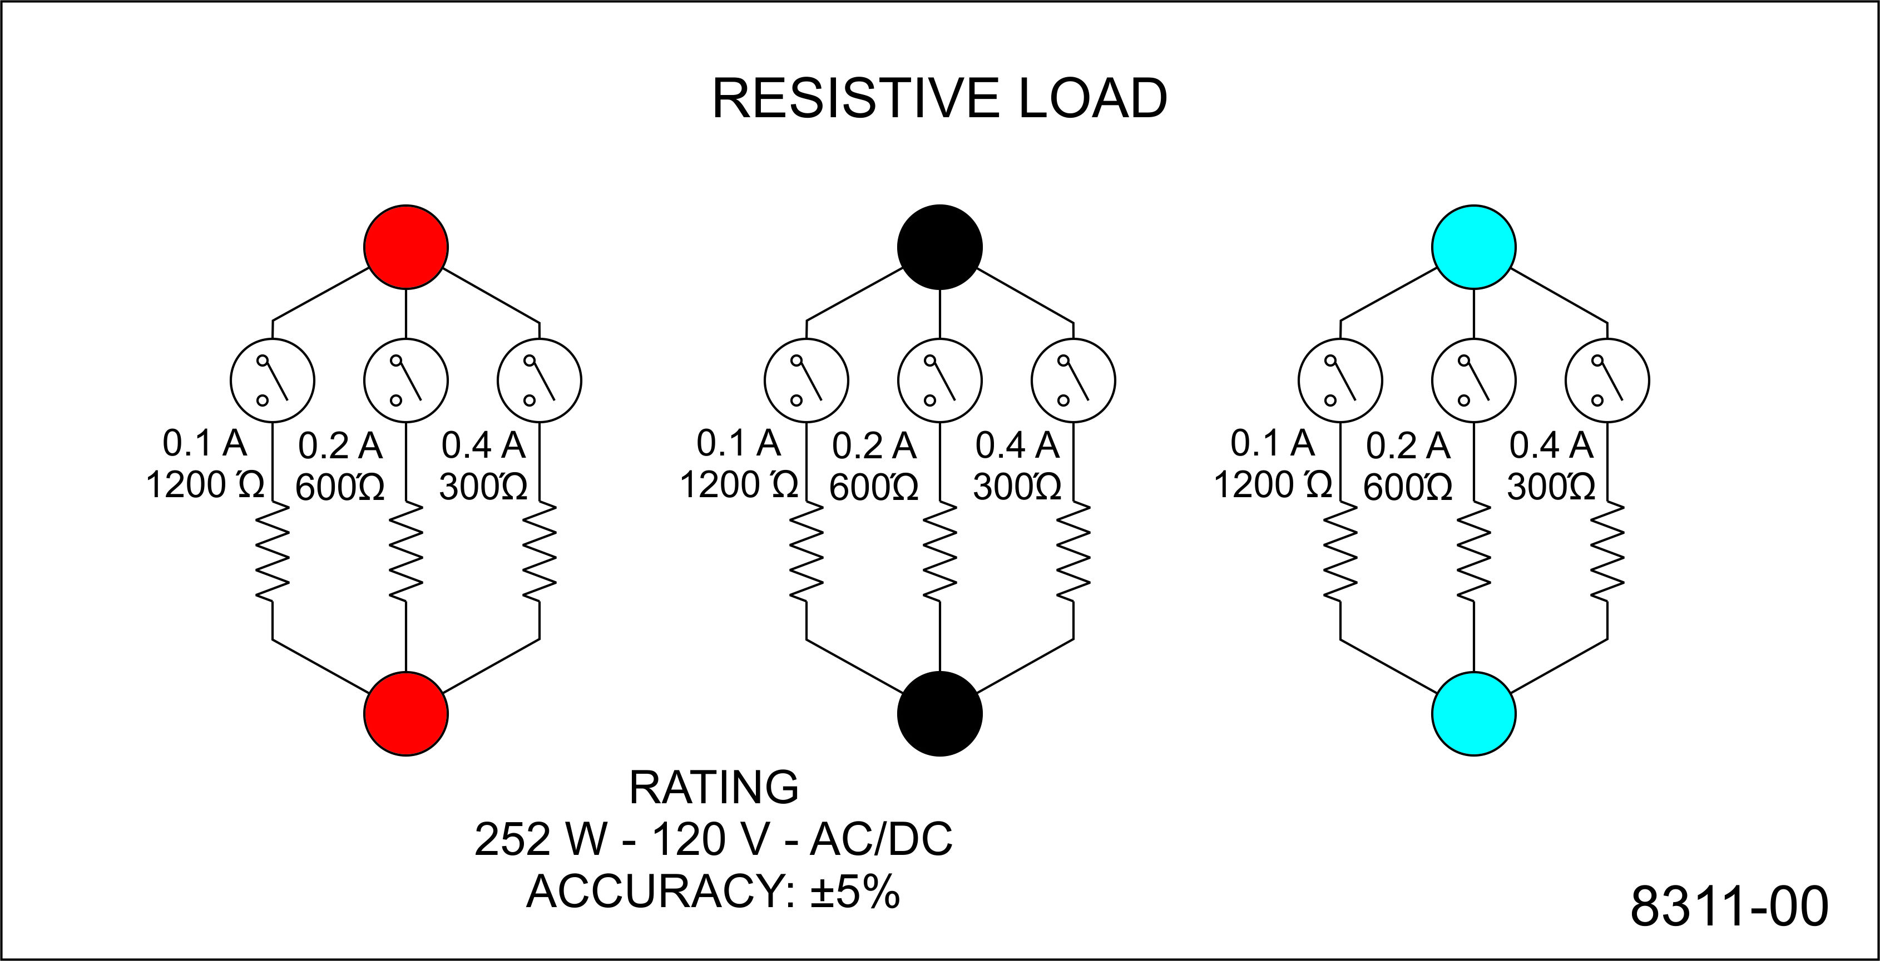
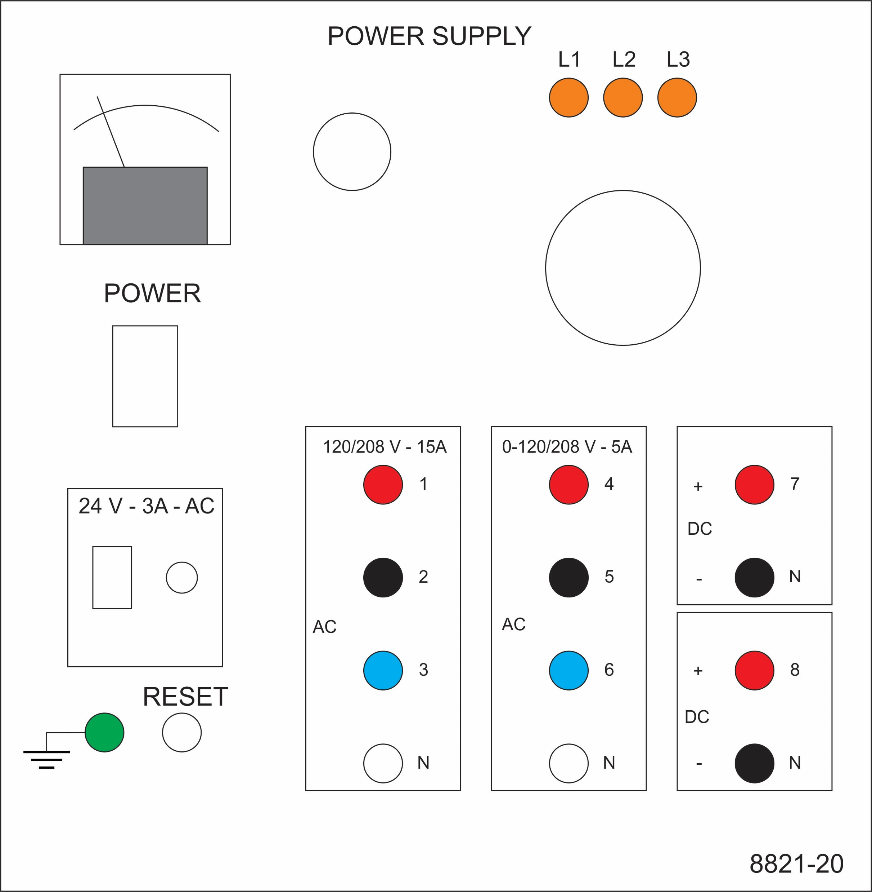
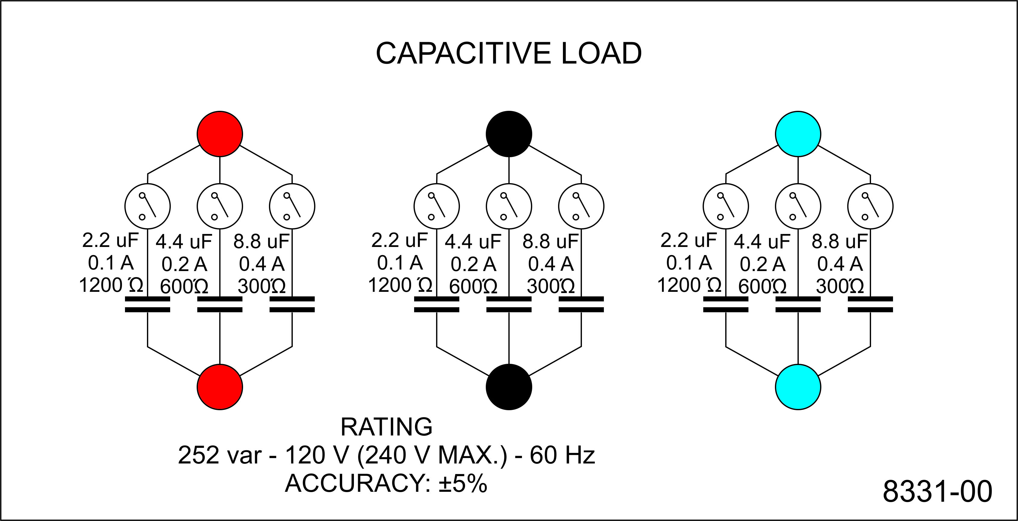
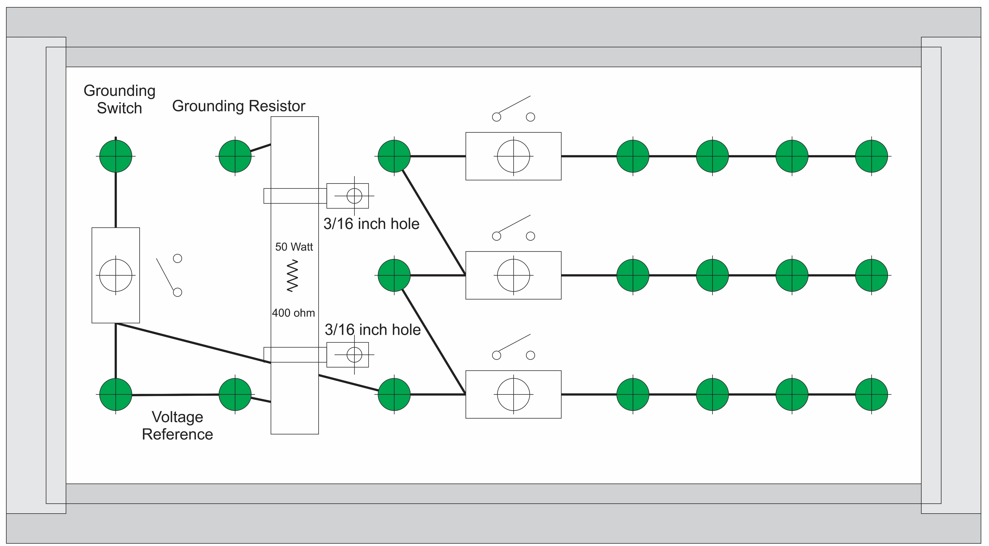
Experiment 8
Secondary - LL
Secondary - LN
Secondary - LG
Primary line
Secondary line
Load line
Wye
Wye-Load
Parasitic

Slide 4
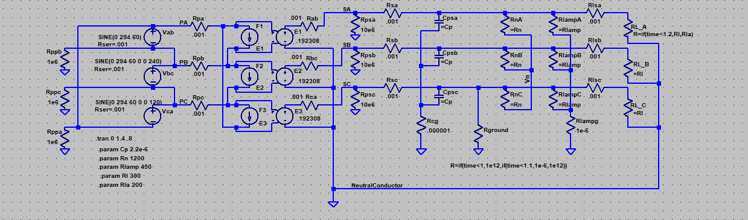
Simulation Model
LTspice
20240928 experiment 8.asc

Slide 5
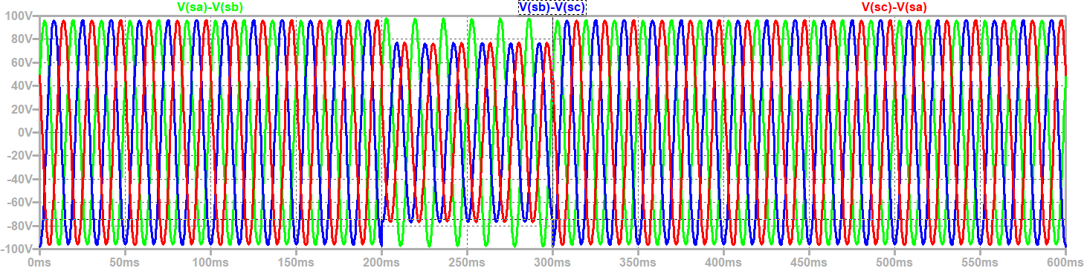
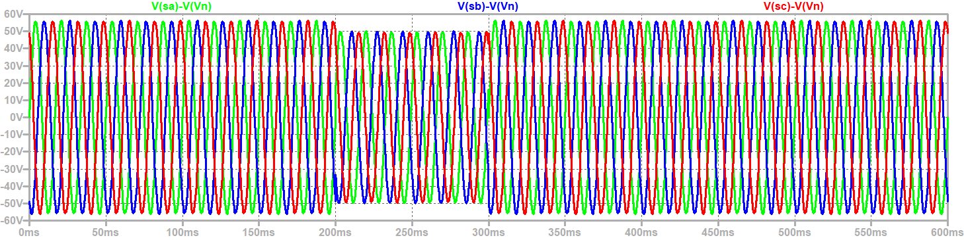
Steady State Voltages – Ground Fault /
Unbalanced Load
$$V_{secondary_ll}=\frac{\sqrt{3}}{n}V_{primary}=\frac{\sqrt{3}}{5.2}208=69.3 volts rms (98 V peak)$$
Secondary Line to Neutral Voltage: Peak = 56.6 V volts
Ground Fault
Unbalanced Load

Slide 6
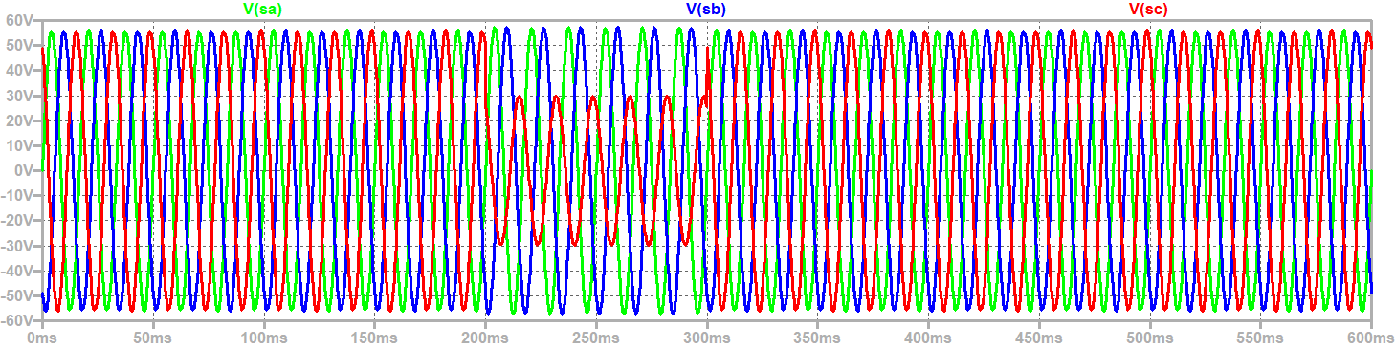
Steady State line to ground Voltages – Ground Fault / Unbalanced Load
Ground Fault
Unbalanced Load

Slide 7
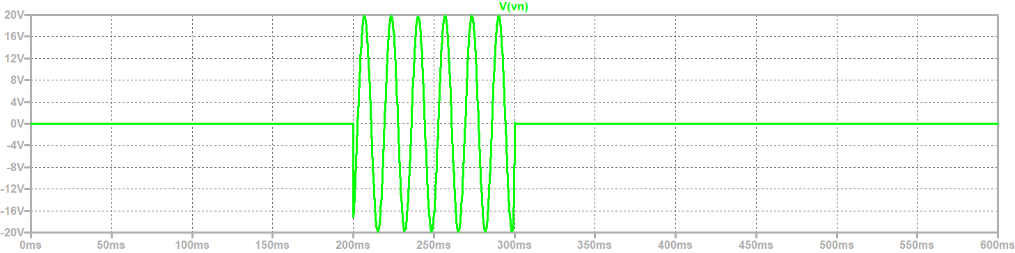
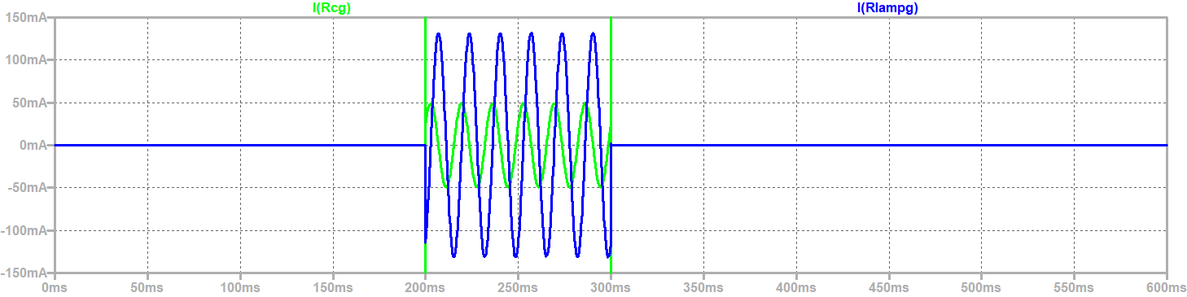
Neutral to ground voltage
(CM Voltage) and CM Current through Parasitic Capacitances or lamp resistances
Neutral to Ground Voltage
Ground Fault
Unbalanced Load
CM Current through Parasitic Capacitances and Lamp Resistors

Slide 8
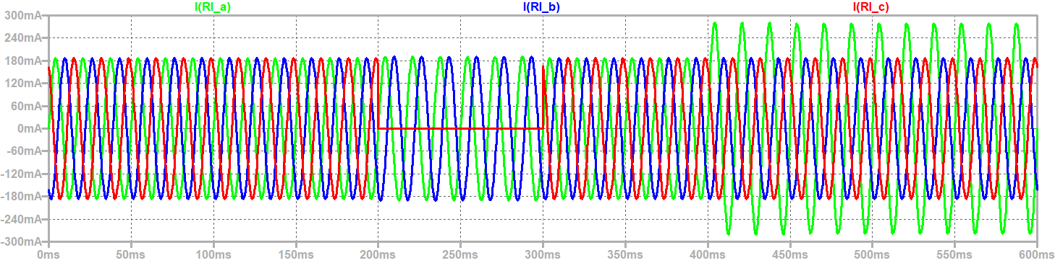
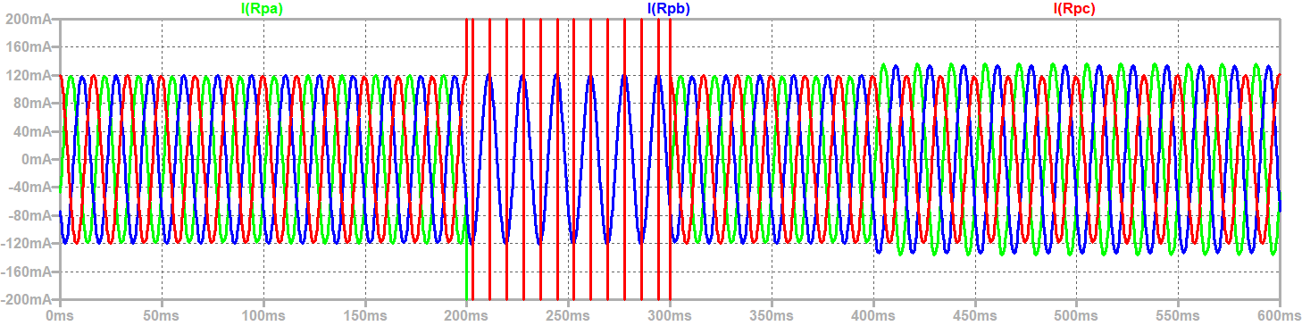
Line currents into the wye load and into primary not balanced with unbalanced load
Current into
Wye load
Ground Fault
Unbalanced Load
Current into
Primary
Large currents during ground fault will activate over-current protection

Slide 9
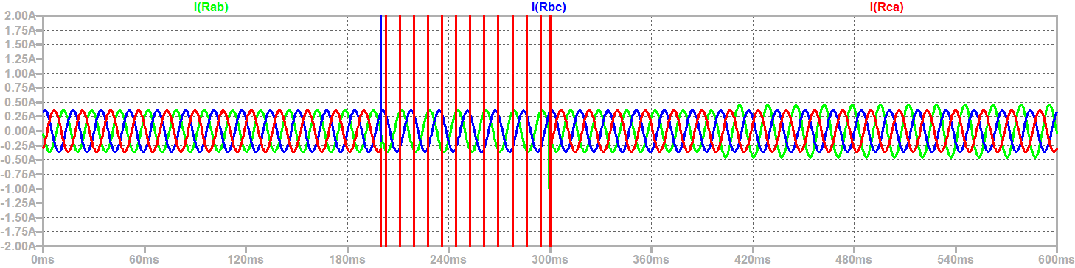
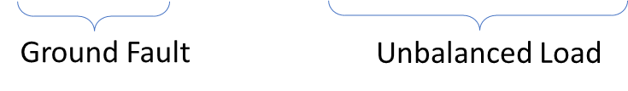
Line Currents out of Transformer
Large currents during ground fault will activate over-current protection

Slide 10
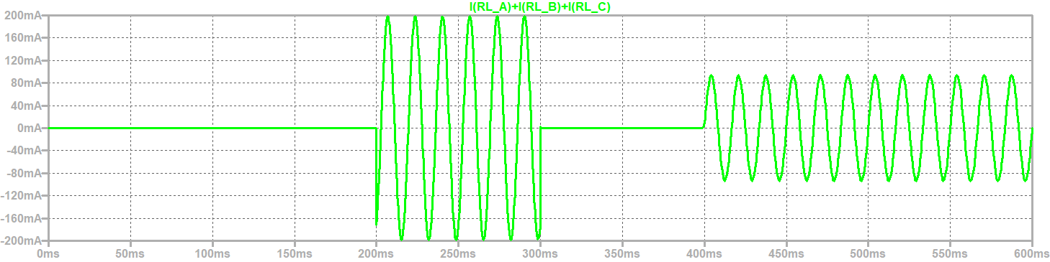
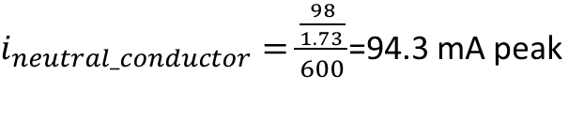
Unbalanced load results in current in the Neutral Conductor
Ground Fault
Unbalanced Load
For unbalanced loads
$i_{neutral_conductor}=\frac{\frac{98}{1.73 }}{600}$=94.3 mA peak

Slide 11
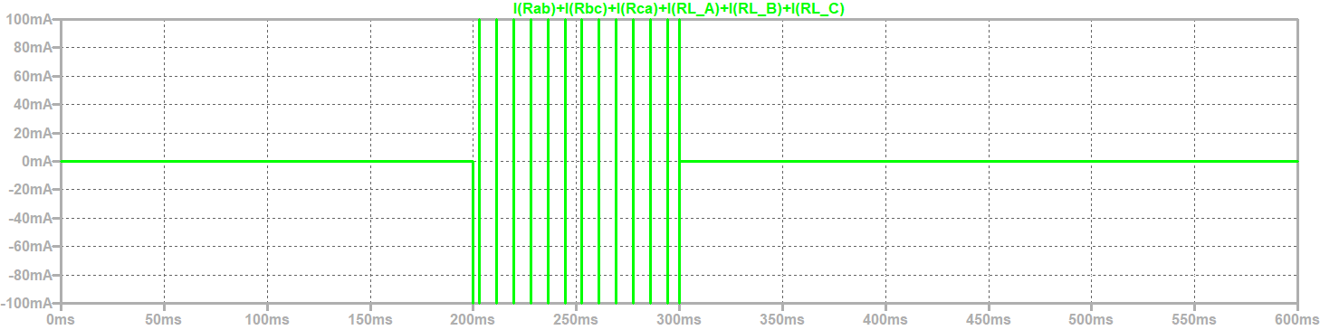
Current through Ground Connection
Ground Fault
Unbalanced Load
No current through the ground connection during an unbalanced load

Slide 12
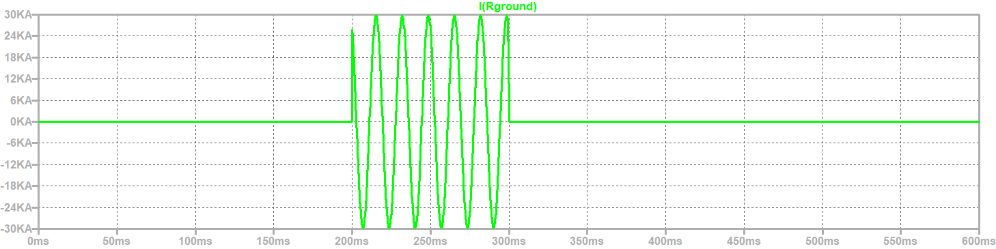
Ground Fault Currents
Ground Fault

Slide 13
Wrap Up

